Slide 1
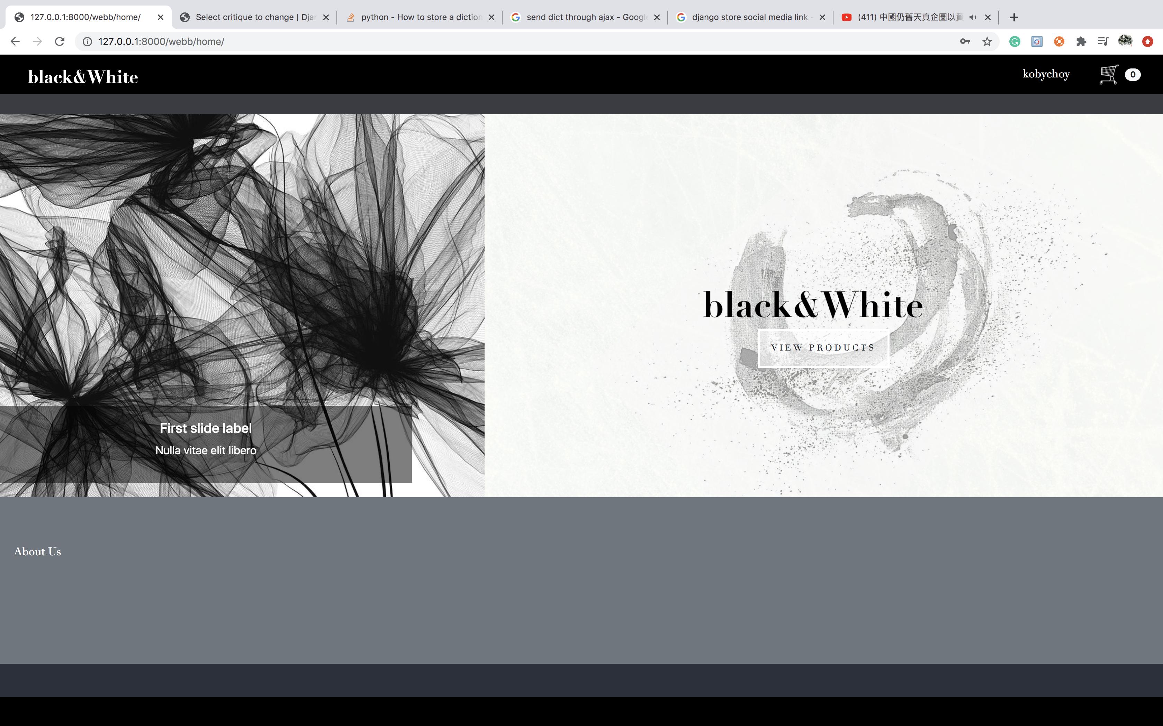
HOME PAGE

Slide 2
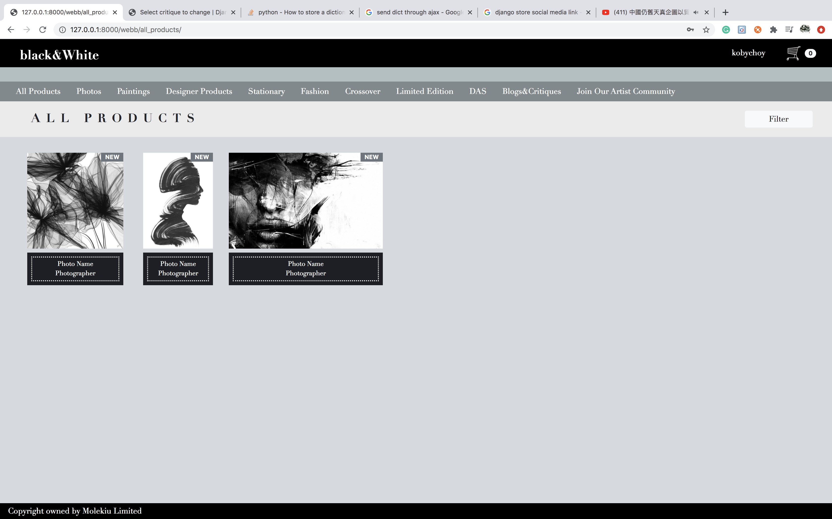
PRODUCT LIST PAGE

Slide 3
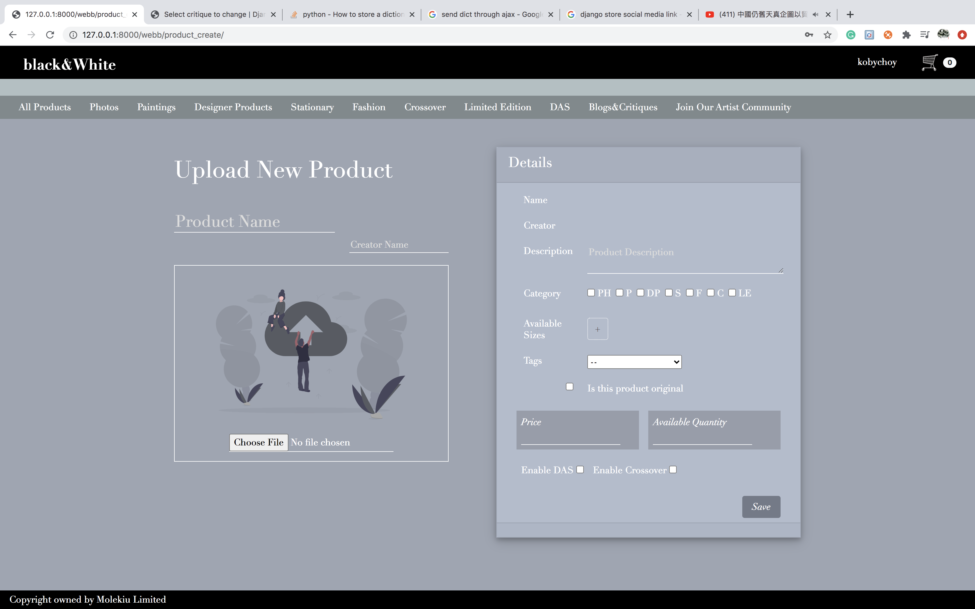
UPLOAD NEW PRODUCT

Slide 4
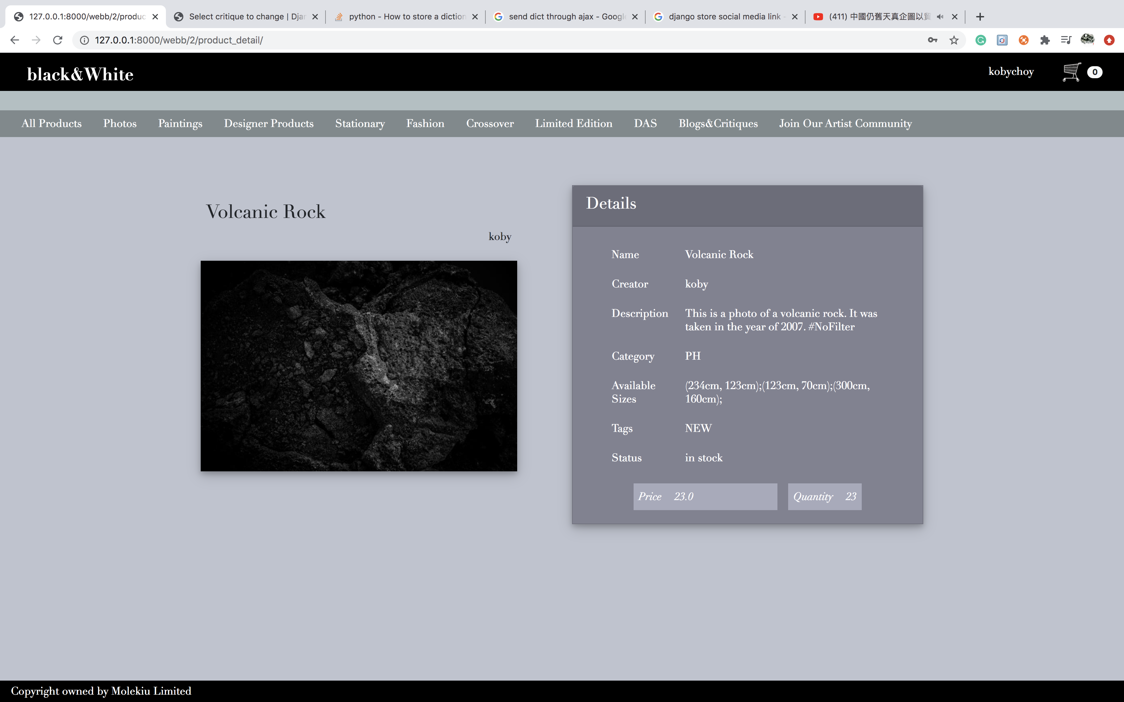
PRODUCT DETAIL PAGE

Slide 5
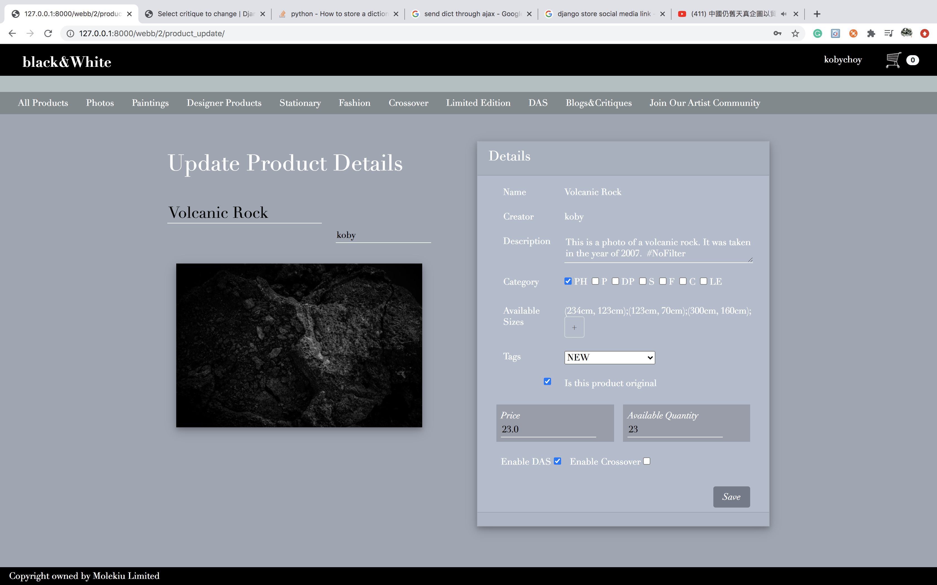
UPDATE EXISTING PRODUCT

Slide 6
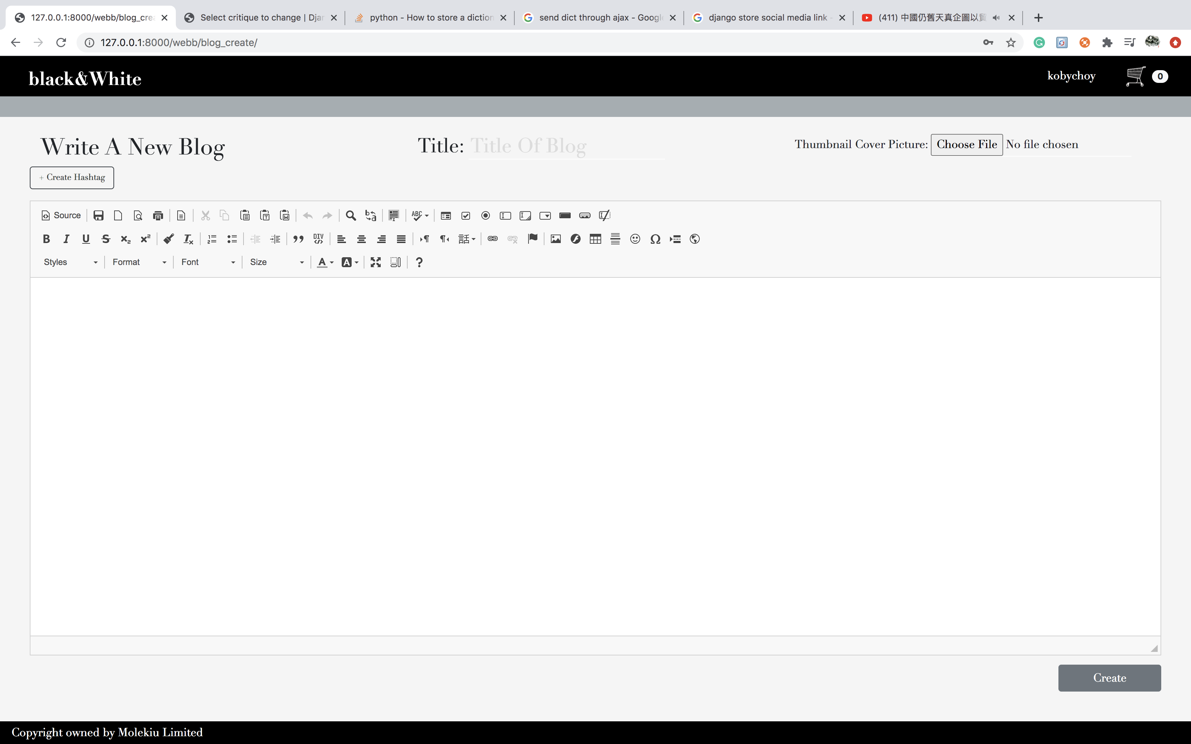
WRITE NEW BLOG

Slide 7
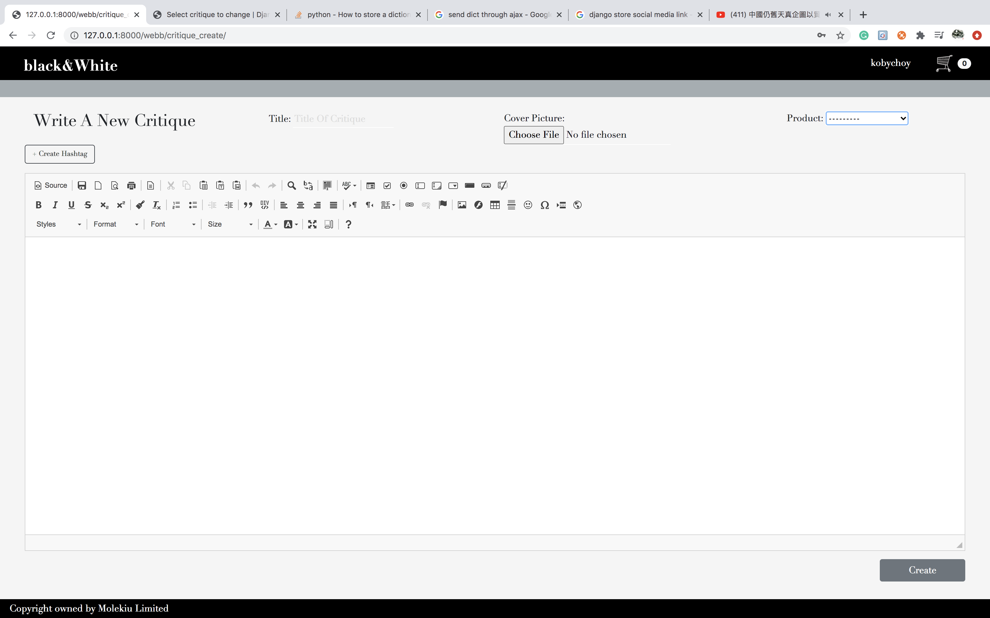
WRITE NEW CRITIQUE

Slide 8
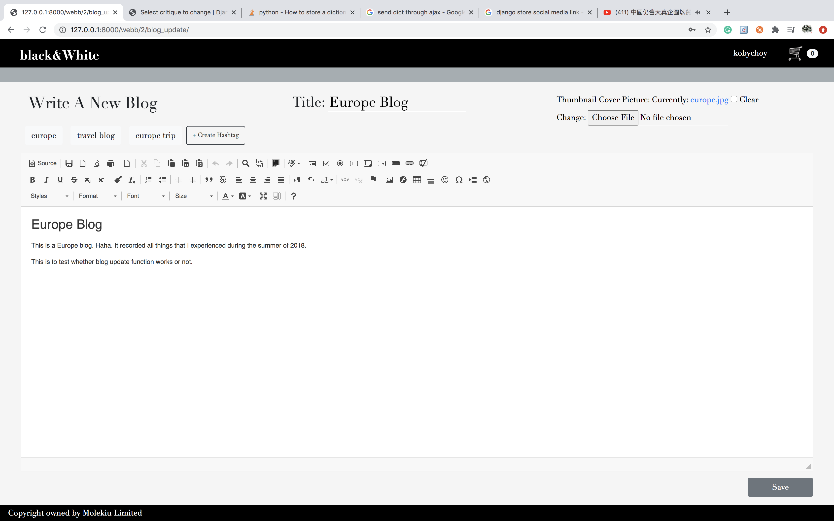
UPDATE EXISTING BLOG

Slide 9
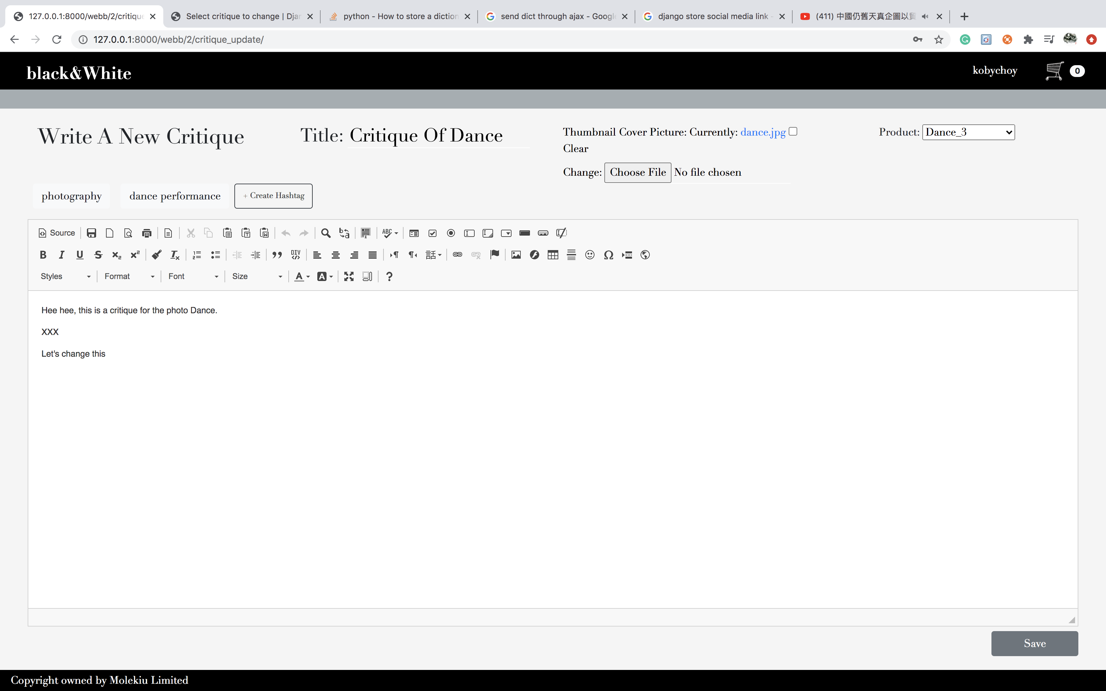
UPDATE CRITIQUE

Slide 10

BLOG DETAIL

Slide 11
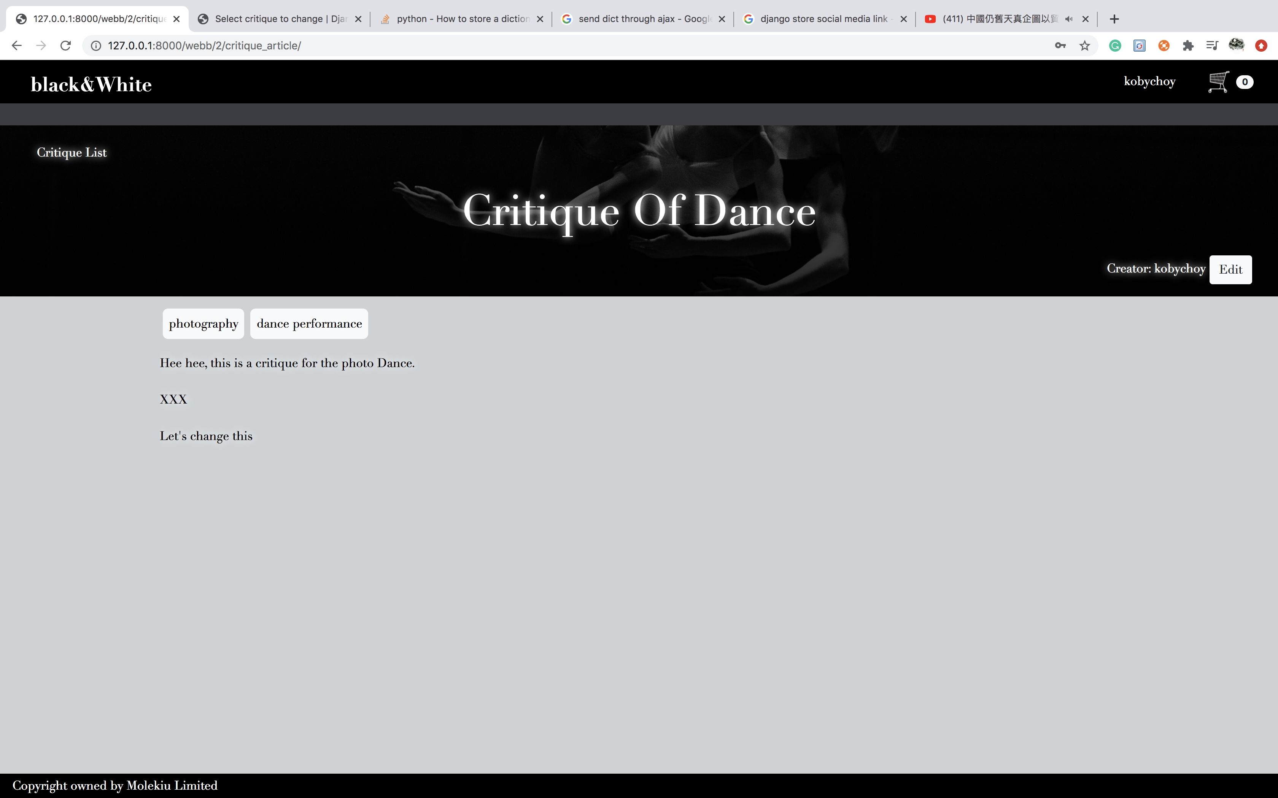
CRITIQUE DETAIL

